Slide 1
Usage of Openstack Cloud Computing Architecture in COE Seowon Jung Systems Administrator, COE seowon@hawaii.edu

Slide 2
Overview
About COE
Prior to OpenStack
What is OpenStack
COE OpenStack
What COE OpenStack runs

Slide 3
College of Education
1,600 students
400 faculty / staff
8 academic departments
2 major research units
- Center on Disability Studies (CDS)
- Curriculum Research & Development Group (CRDG)

Slide 4
Prior to OpenStack
1 Firewall
2 LDAP / DNS
1 DHCP
8 Servers for web services and storages
1 VMware ESXi for developing and VPN
Issues: Tedious and limited resources for developers to expand or launch new services

Slide 5
What is OpenStack
Amazon-like cloud services in their own data centers
OpenSource project
- Began in 2010 as a joint project of NASA and Rackspace Hosting
- Foundation supported by more than 200 companies
- More than 500 companies have joined the project
OpenStack lets end-users deploy virtual machines through a common web interface

Slide 6
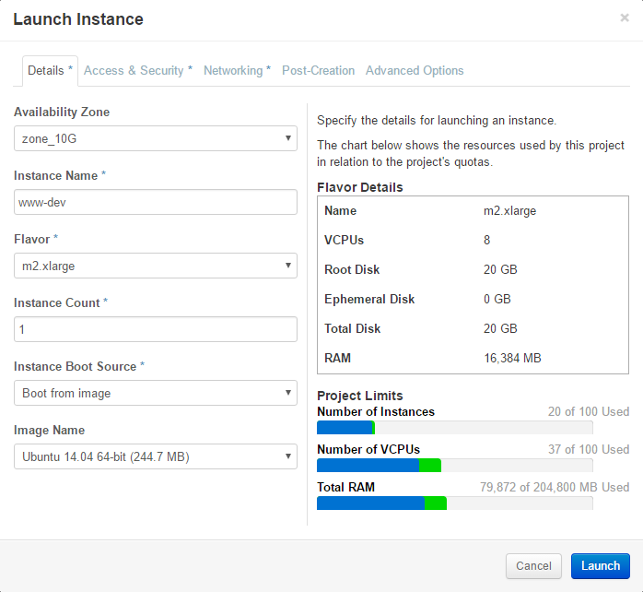

Slide 7
COE OpenStack
Initially deployed in January, 2013
OpenStack IceHouse (9th release) on Ubuntu 14.04
7 Compute nodes
3 Controller nodes with H/A
3 Block / Object storage nodes
Total 320 CPU cores, 1.6 TB RAMs, and 180 TB HDDs

Slide 8
COE OpenStack
Compute nodes
- Hypervisor – KVM
- Networking agent – OpenVSwitch, multiple VLANs
Controller nodes
- Message queue – RabbitMQ
- Identity service – LDAP
- image service – Multiple Linux distros
- Storage management – Block / Object storage

Slide 9
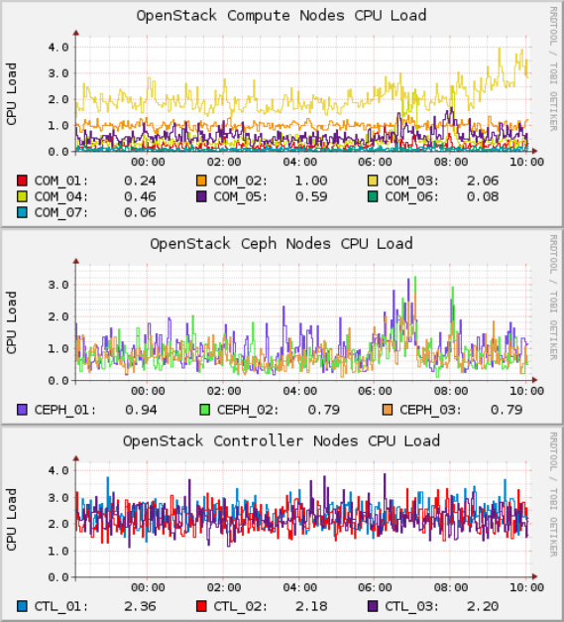
COE OpenStack
Storage nodes
- Ceph Block / Object storage service
13 OpenStack nodes:
- 13 physical servers run 120 virtualservers
- Run over 40 websites and 120 instances
- less than 10% of utilization

Slide 10
What COE OpenStack runs
COE official website
Public / private websites for each department
7 Read-only LDAP servers
ownCloud File Sync & Sharing platform
- Provided a data storage resource for faculty / staff
- Upload link for students
Identity integration with LDAP for OpenStack Web-Interface

Slide 11
What COE OpenStack runs
Student Information System
Classroom & Equipment reservation system
Websites for supporting faculty / staff
Pre-configured virtual servers for staff and faculty

Slide 12
Thank you
Seowon Jung
seowon@hawaii.edu

